Slide 1
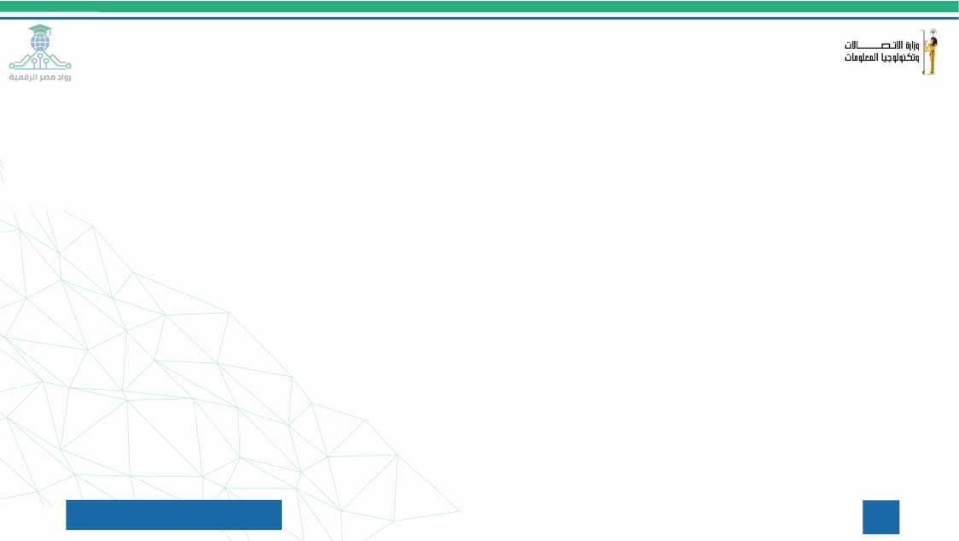
Attack & Detection
Documentation

Slide 2
Attack & Detection Documentation
Use Case 1: Create account attack
• Tool Used: Atomic Red Team (ART)/ Command Prompt (Manual Execution)
• Target Machine (Victim): Windows 11 VM (Host Name: asus)
• MITRE ATT&CK Tactic: Persistence
• MITRE ATT&CK Technique: Create Account: Local Account (T1136.001)
• Simulation Mechanism: Self-Simulation (The host executes the technique locally to simulate a compromised scenario).
Attack Scenario Description
This test simulates a post-compromise activity where an attacker creates a new local user account on the system. This ensures the attacker maintains a "backdoor" for persistent access to the victim's environment, allowing them to log back in even if the primary vulnerability or access vector is patched.
SIEM Rule Deployment
• Rule Name: Persistence - Unauthorized Local Admin Account Created
• Severity: Medium
• Detection Logic (Event ID): 4720

Slide 3
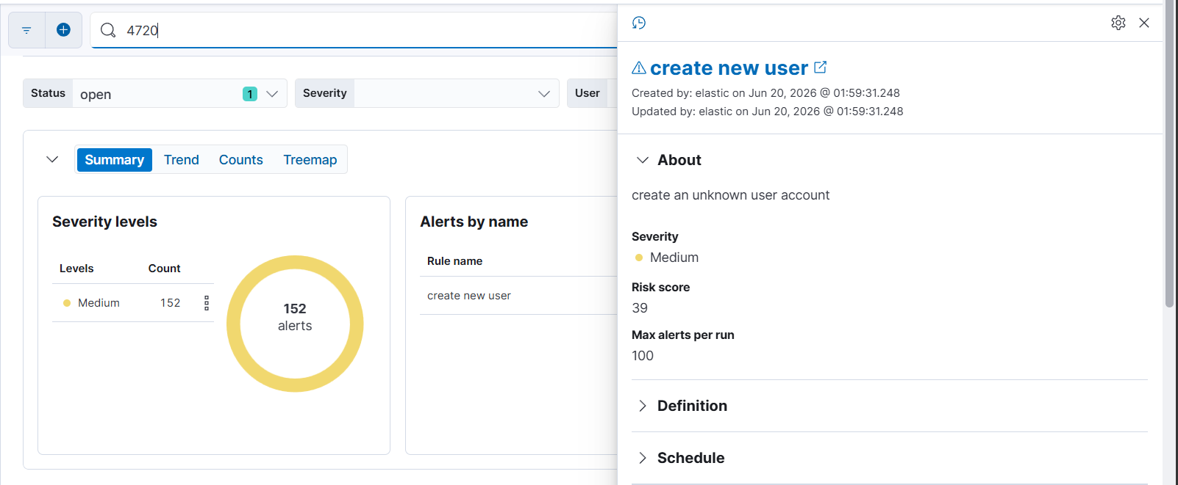
>> Create unknown user account
event_id: 4720 (إنشاء الحساب).

Slide 4

Simulate Create unknown user account using CMD
1- @ CMD write :
2- Then click Enter

Slide 5
Alert Triage:
Alert Name | Create new user
Severity | medium
Host | Asus
MITRE | T1136.001
Status | True positive
Analyst Notes | New unknown user account are created

Slide 6
Use Case 2: Privilege Escalation attack
• Tool Used: Command Prompt (Manual Execution)
• Target Machine (Victim): Windows 11 VM (Host Name: asus)
• MITRE ATT&CK Tactic: Privilege Escalation
• MITRE ATT&CK Technique: Account Manipulation (T1098)
• Simulation Mechanism: Self-Simulation (The host executes the technique locally to simulate a compromised scenario).
Attack Scenario Description
This test simulates a post-compromise activity where an attacker adds a previously created or compromised local user account to a high-privileged group, such as the local Administrators group. By doing so, the attacker successfully escalates their privileges, granting them full administrative control over the target machine to disable security controls or execute further malicious actions.
SIEM Rule Deployment
• Rule Name: Privilege Escalation - User Added to Local Administrators Group
• Severity: High
• Detection Logic (Event ID): 4732

Slide 7
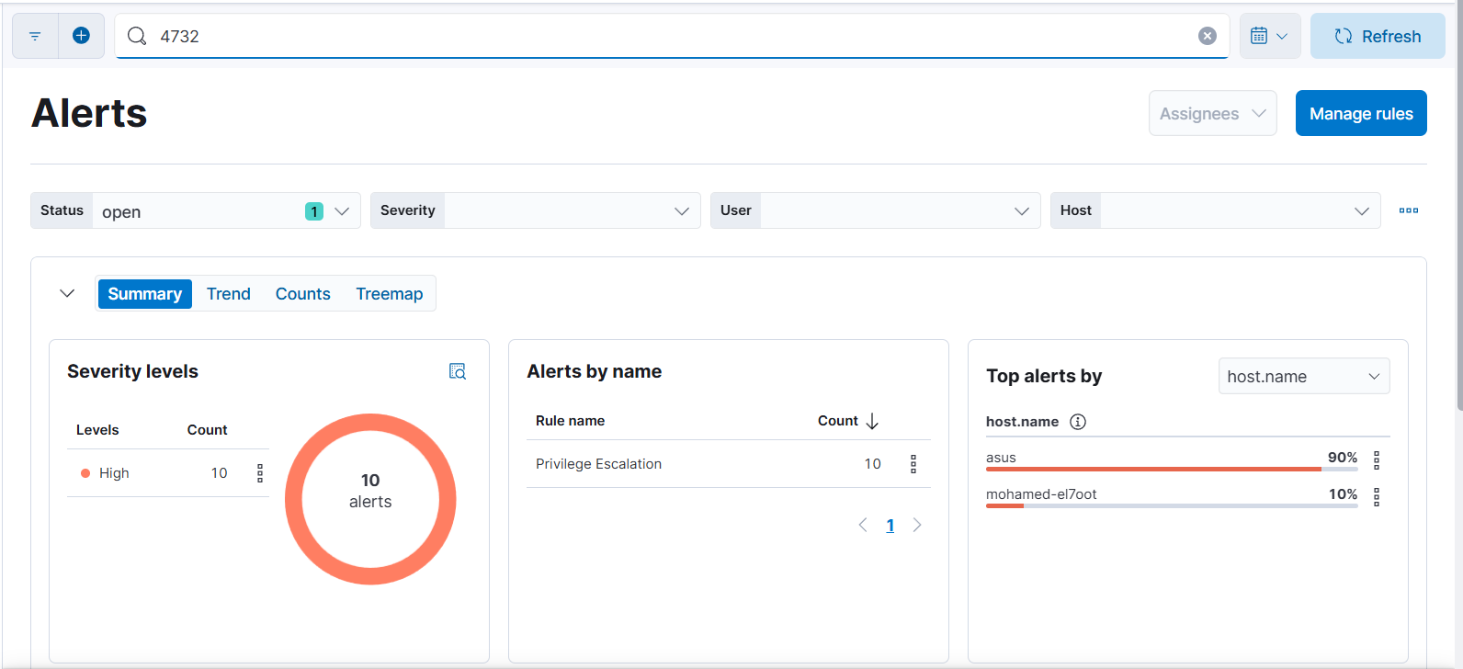
>>Privilege Escalation
event_id: 4732 (إضافته للأدمن).

Slide 8

Simulate Privilege Escalation using CMD
1- @ CMD write :
2- Then click Enter

Slide 9

Simulate attack using atomic red team
Technical Execution Steps on atomic red team
Step 1: Import the Atomic Red Team Module
Step 2: Execute the Specific Attack Test
Depend on MITRE ATT&CK ID to simulate a specific attack

Slide 10
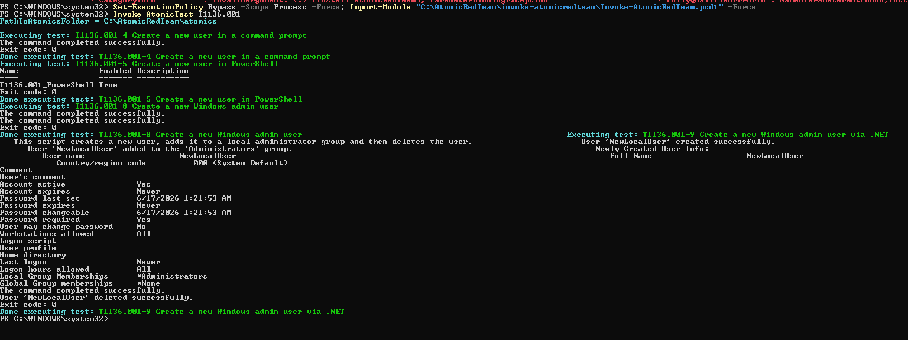
Created a new local user named NewLocalUser
Successfully added the user to the Administrators group
)Privilege Escalation(

Slide 11
Alert Triage:
Alert Name | Privilege Escalation
Severity | High
Host | Asus
MITRE | T1098
Status | True positive
Analyst Notes | Unauthorized User Added to Local Administrators Group

Slide 12
Attack & Detection Documentation
Use Case 3: Brute Force attack
• Tool Used: Atomic Red Team (ART)
• Target Machine (Victim): Windows 11 VM (Host Name: asus)
• MITRE ATT&CK Tactic: Credential Access
• MITRE ATT&CK Technique: Brute Force ) T1110(
• Simulation Mechanism: Self-Simulation (The host executes the technique locally to simulate a compromised scenario).
Attack Scenario Description
This test simulates an authentication exploitation tactic where an attacker or an automated script attempts to gain unauthorized access to a system by guessing local account passwords. By executing a rapid looping sequence of incorrect login attempts, the simulation forces the Windows subsystem to trigger defense telemetry, allowing the SOC team to detect malicious credential-hunting patterns before a successful breach occurs.
SIEM Rule Deployment
• Rule Name: Credential Access – Brute Force Detection
• Severity: Medium (Can be escalated to High if thresholds are breached within a short timeframe)
• Detection Logic (Event ID): 4625

Slide 13
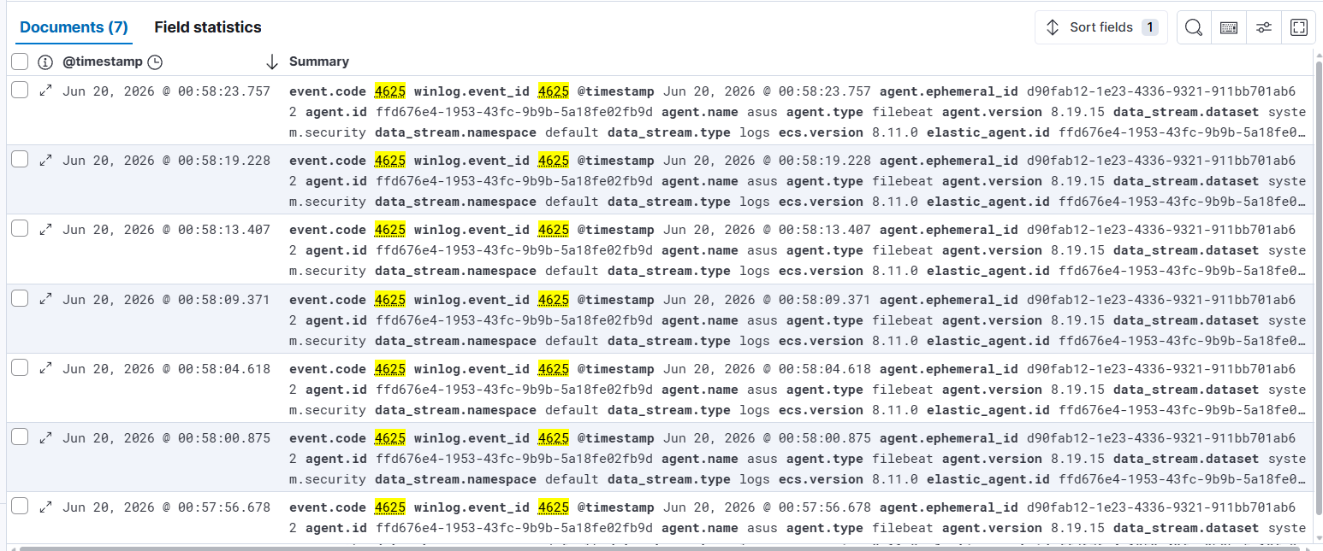
event_id: 4625 (failed login )

Slide 14
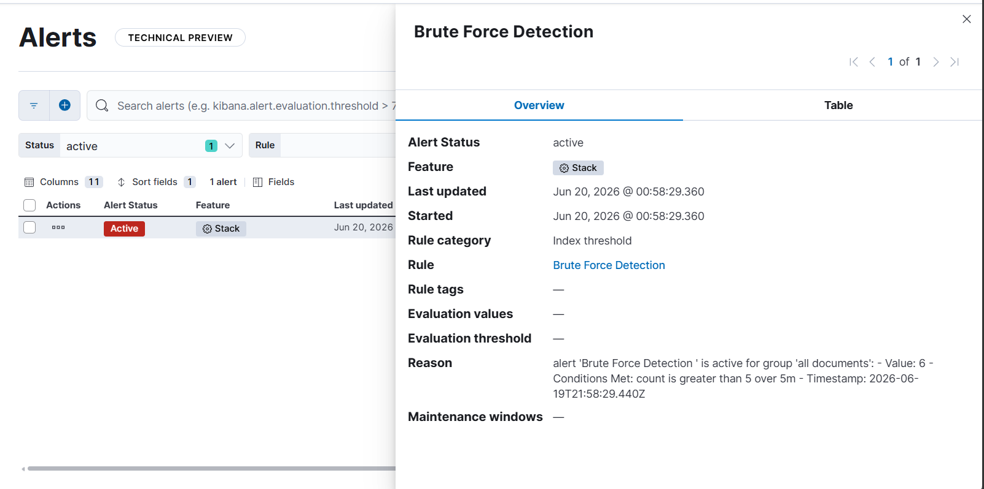
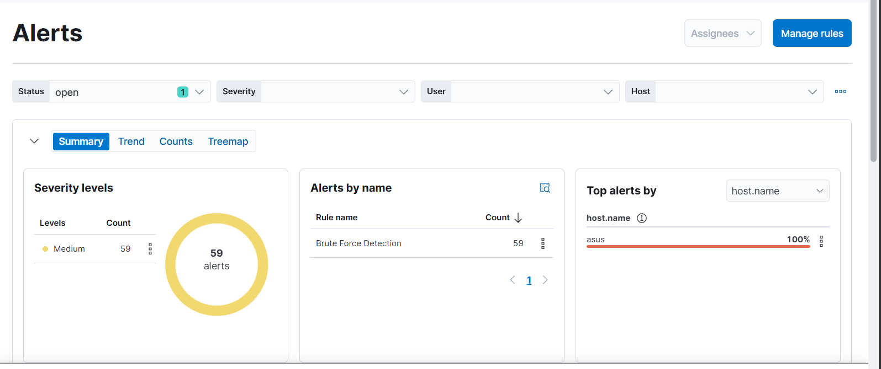

Slide 15

Simulate Brute force attack
1- @ CMD write :
2- Then click Enter
3- Then write any uncorrect password
Repeate this steps 5 times to trigger the alert

Slide 16
Alert Triage:
Alert Name | Credential Access – Brute Force Detection
Severity | Medium
Host | Asus
MITRE | T1110
Status | True Positive
Analyst Notes | Multiple failed login attempts detected

Slide 17



Indicators of Compromise (IOCs)
Use Case 1: Create account attack
•
•
Use Case 2: Privilege Escalation attack
Use Case 3: Brute Force attack
•

Slide 18
Incident Response Recommendations
Guidance notes and recommended actions to mitigate and resolve the detected attack
• Create Account
Disable suspicious account. Review local users. Audit account creation activities.
• Privilege Escalation
Remove unauthorized administrator. Review privilege assignments. Reset affected credentials.
• Brute Force
Enable account lockout policy. Change password. Enable MFA (Multi-Factor Authentication).

Slide 19
SIEM Rule Deployment & Triggering Workflow:
•
Rule Configuration: Custom detection rules are built within Kibana to continuously analyze incoming log streams from monitored endpoints.
Detection Logic: Each rule is precisely defined using KQL (Kibana Query Language) to target the specific Windows Event ID that represents a particular attack technique or suspicious activity.
Alert Triggering: When an ingested event matches the predefined Event ID and rule conditions, the SIEM automatically generates and escalates an alert to the security dashboard for analyst review.
•
•

